Slide 1
SSIS
SQL Server Integration Service

Slide 2
Extract
ETL
Transform
Load
Sources
Transforms
Destinations

Slide 3
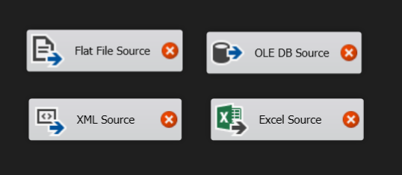
Sources

Slide 4
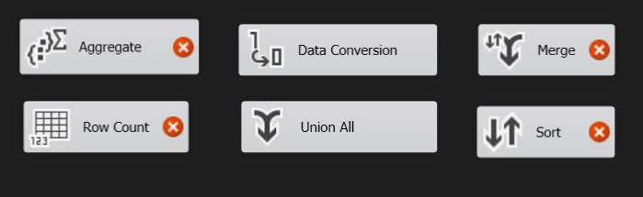
Transforms

Slide 5
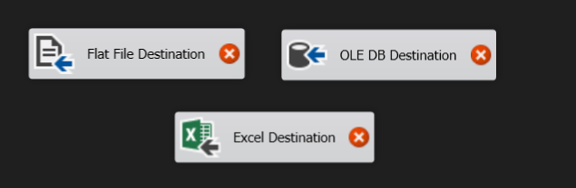
Destinations

Slide 6
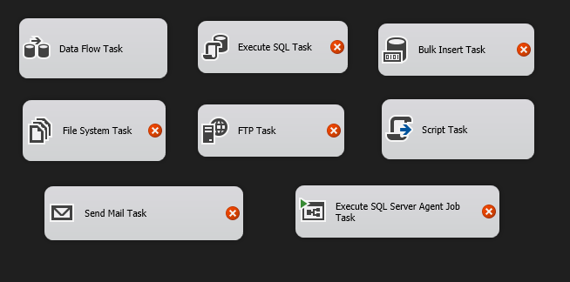
Tasks

Slide 7
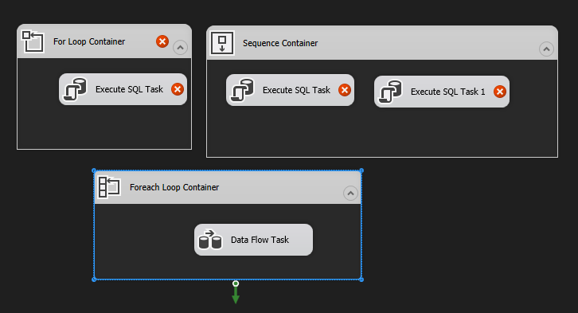
Containers

Slide 8
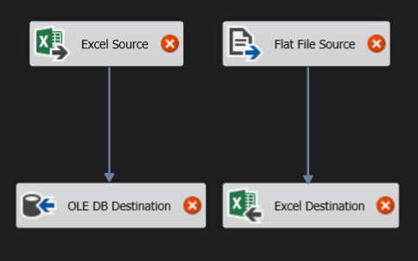
Examples

Slide 9
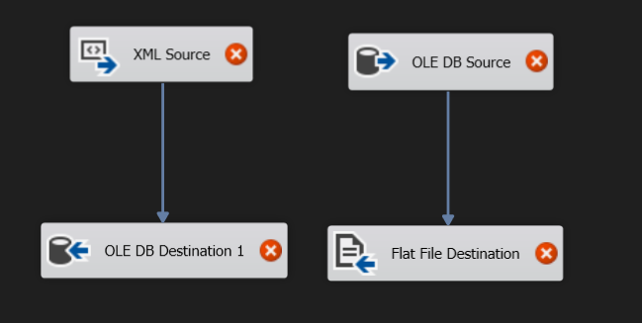
Examples

Slide 10
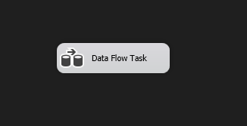
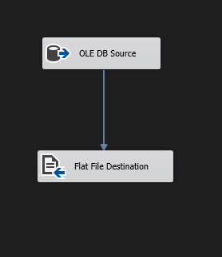
Demo (From DB To Flat File)
Control Flow
Data Flow

Slide 11
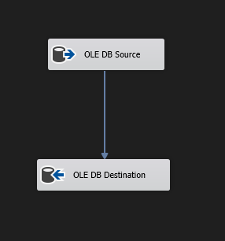
Demo (From DB To Another)
Control Flow
Data Flow

Slide 12
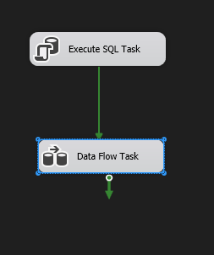
Demo ( SQL Task )
Control Flow
Data Flow

Slide 13
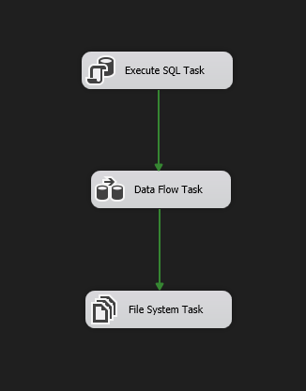
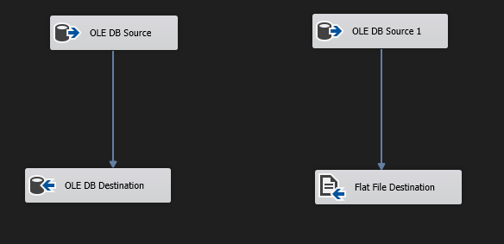
Demo ( File System Task )
Control Flow
Data Flow

Slide 14
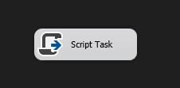
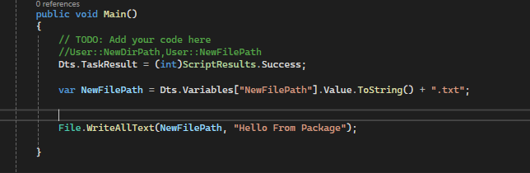
Demo ( Script Task + Variables)
Control Flow
Main Script

Slide 15
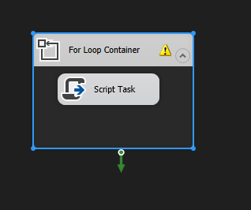
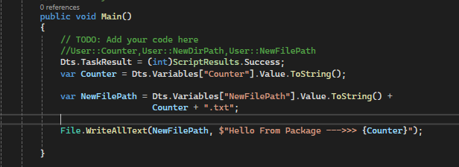
Demo ( Looping)
Control Flow
Main Script

Slide 16
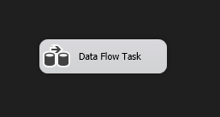
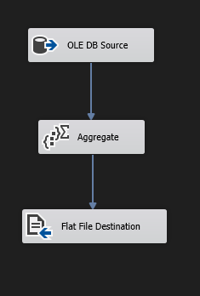
Demo ( Aggregate)
Control Flow
Data Flow

Slide 17
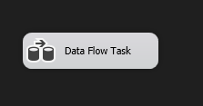
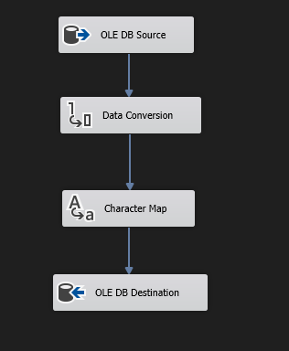
Demo ( Data Conversion – Char Mapping)
Control Flow
Data Flow

Slide 18
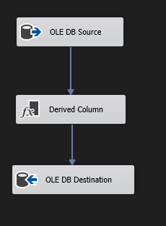
Demo ( Derived Columns)
Control Flow
Data Flow

Slide 19
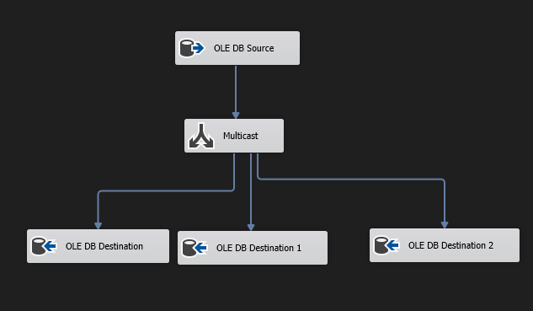
Demo ( Multi Cast)
Control Flow
Data Flow

Slide 20
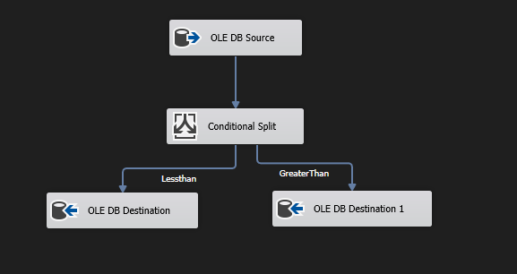
Demo ( Conditional Split)
Control Flow
Data Flow

Slide 21
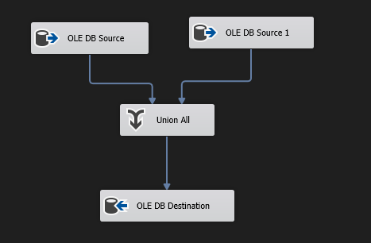
Demo ( Union All)
Control Flow
Data Flow

Slide 22
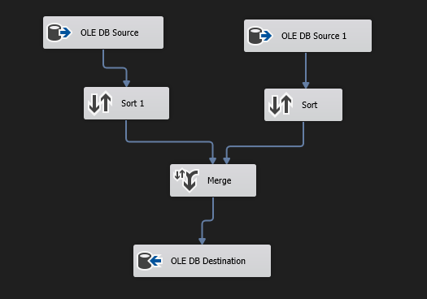
Demo ( Merge)
Control Flow
Data Flow

